Slide 1
Enhancing Book Discovery: A Deep Dive into Collaborative Filtering and Popularity- Based Recommendation Systems

Slide 2

Introduction to Book Discovery
In today’s world of digital content, the sheer volume of books available can be overwhelming for readers. A book recommendation system is a powerful tool to bridge the gap between readers and the books they most likely enjoy. By leveraging advanced algorithms, user preferences, and diverse data sources, these systems provide personalised suggestions tailored to individual tastes.
The system utilises the Books Dataset from Kaggle, containing a diverse collection of book images and relevant metadata. By performing EDA on data, Collaborative filtering analyses user interactions, such as ratings or reviews, to identify patterns and recommend books that similar users have enjoyed.

Slide 3

The development of the Book Recommendation System involved the following key steps: Dataset Preparation: The project utilized the Books Dataset from Kaggle, comprising high-quality fashion product images and metadata. Data preprocessing steps included resizing images to a consistent dimension, normalizing pixel values, and removing duplicate or irrelevant entries to ensure data quality and uniformity. Data Preprocessing: Data quality is critical for building a reliable recommendation system. The following preprocessing steps are applied: Missing Value Handling: Checked and handled missing values across all datasets to ensure completeness. Duplicate Removal: Removed duplicate entries to prevent biases in calculations. Popularity-Based Recommendation System: This approach identifies and recommends books that are widely liked by users based on aggregate metrics. The steps include: Calculating Number of Ratings: Counted the total number of user ratings for each book to determine its popularity. Computing Average Ratings: Computed the mean rating for each book to assess its overall quality. Threshold-Based Filtering: Selected books with a high average rating and a minimum threshold of user reviews to ensure that recommendations are both popular and credible.

Slide 4

Implementation
The following steps were implemented:
Data Exploration: Loaded and analyzed the dimensions and characteristics of the datasets.
Popularity-Based Recommender:
Merged ratings and book data to create a combined dataset.
Computed aggregate metrics include each book's number of ratings and average ratings.
Filtered books with high ratings and many user reviews for recommendations.
Collaborative Filtering:
Employed user-item interaction matrices.
Likely used algorithms like cosine similarity or matrix factorization for identifying similar users/books.
Recommended books to users based on those liked by similar users.

Slide 5
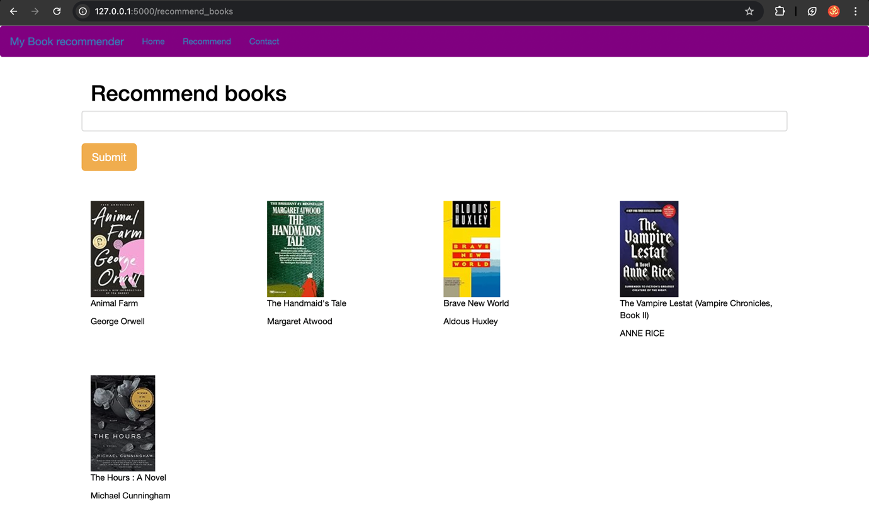
Working of Book Recommendation System

Slide 6

CONCLUSION AND SCOPE
The popularity-based system excels in simplicity and effectiveness for new users and those exploring mainstream content. By highlighting books with high average ratings and substantial review counts, it ensures a reliable introduction to widely appreciated titles. However, its generalized nature limits its ability to cater to individual preferences.
The collaborative filtering system, on the other hand, offers tailored recommendations by analysing user-item interactions. This approach identifies patterns in user behaviour, uncovering connections between books and users with similar interests. While collaborative filtering enhances user satisfaction through personalisation, its dependence on user engagement and existing data poses challenges, particularly for new users or sparsely rated items.
Advanced Machine Learning Techniques
Adopt advanced algorithms like:
Matrix Factorization (e.g., SVD): To handle sparse datasets more effectively and uncover latent factors in user-book interactions.
Deep Learning Models: Utilize neural networks to model complex relationships between users and books, enabling richer recommendations.

